Slide 1
Bayesian Analysis of Clinical Trial Data Using Pymc3
Project 2
Group 3
DSCI6653
PROFESSOR: MINKYU KIM
05/05/2024

Slide 2

Team Members
Ashish Agarwal
Srikanth Dumpala
Rishikeshwar Kankurthyshetty
Rahul Kumar Mavuri
Harika Suravarapu
Jammigumpula Vamsi Krishna
PAGE 02

Slide 3
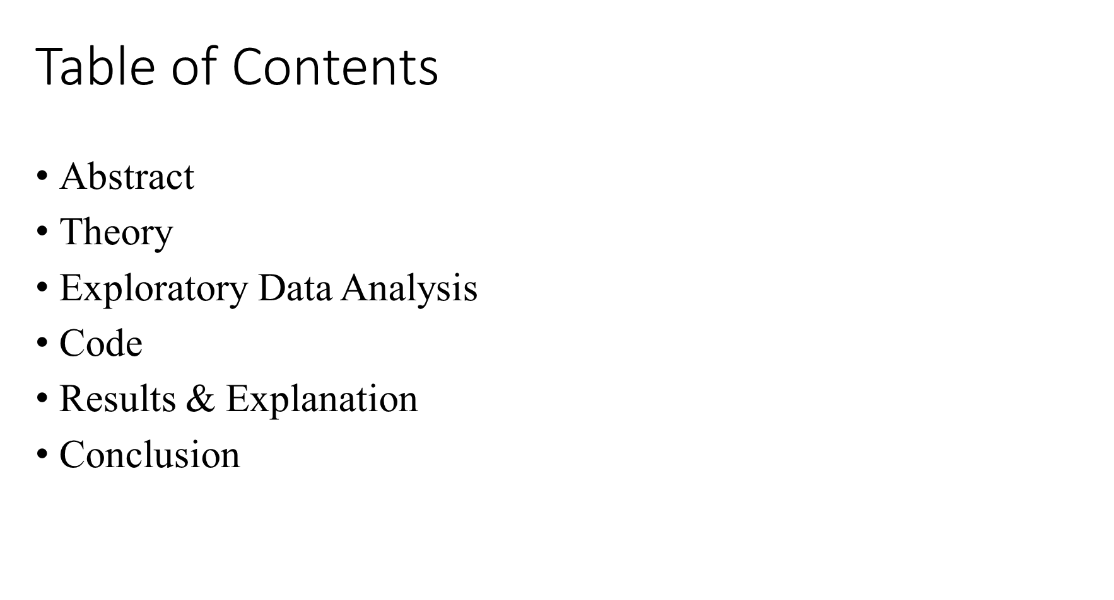
PAGE 03

Slide 4
ABSTRACT
Investigating Efficacy: Study focuses on evaluating a new blood pressure medication's effectiveness through a clinical trial.
Participant Selection: Individuals currently on standard medication are divided into treatment and control groups.
Targeted Range: Emphasis on patients with systolic blood pressures ranging from 140 to 180 mmHg.
Sample Size: 3 groups:
Case 1: 70 TP and 50 FP are observed in 100 targets and 100 noise trials.
Case 2: 7 TP and 5 FP are observed in 10 targets and 10 noise trials.
Case 3: 10 TP and no FP in 10 targets and 10 noise trials.
Estimation Techniques: Estimations of Bayesian methods for parameters like discriminability, bias, true positive rate, and false positive rate across three cases offer insights into medication efficacy and statistical evaluation techniques.
PAGE 04

Slide 5
THEORY
Bias in Binary Classification: Indicates a preference towards one class regardless of actual class membership.
Discriminability: Measures the ability to distinguish between classes by comparing their means relative to standard deviation.
True Positive (TP) and False Positive (FP): TP signifies correct positive predictions, while FP represents incorrect positive predictions.
Binomial Distribution: Models the probability of observed data based on TP and FP in fixed trials, suitable for this scenario.
Theano Tensor Operations: In pymc3, calculate the cumulative distribution function (CDF) of a normal distribution.
Normal Distribution: Characterized by mean and variance, commonly used to model real-world phenomena due to its bell-shaped curve.
PAGE 05

Slide 6
EDA : Exploratory Data Analysis
The code conducts Bayesian inference to estimate true positive and false positive rates for three binary classification models.
The 'observed_data' dictionary contains the recorded data, encompassing true positives, false positives, total positive samples, and total negative samples.
The code uses PyMC3, a probabilistic programming library, to define and perform Bayesian inference on the models.
A phi function calculates the cumulative distribution function of a normal distribution, representing the likelihood of correct classification. It utilizes the error function ('erf') from the PyMC3 library's theano.tensor module, which measures the probability of a value falling within a specific range.
Normal distributions are assigned as priors for latent variables, while observed variables are modeled using binomial distributions for likelihood.
PAGE 06

Slide 7
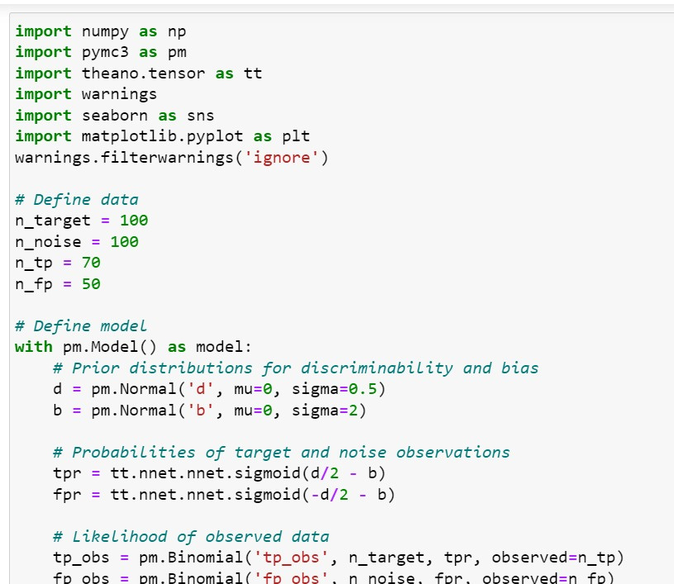
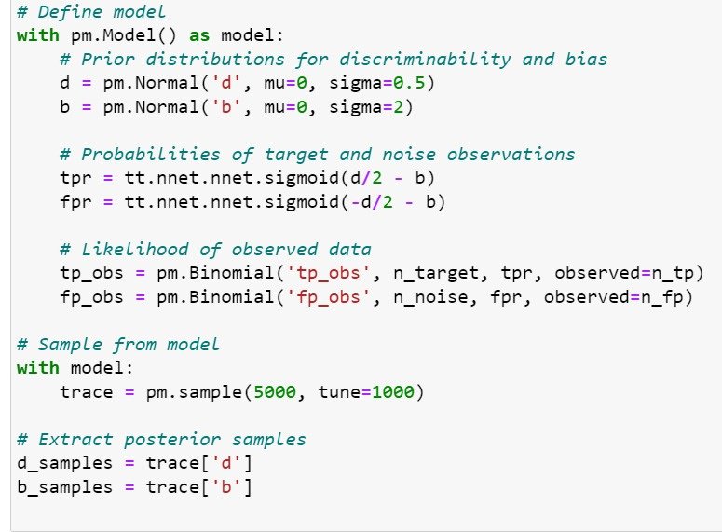
PAGE 07

Slide 8
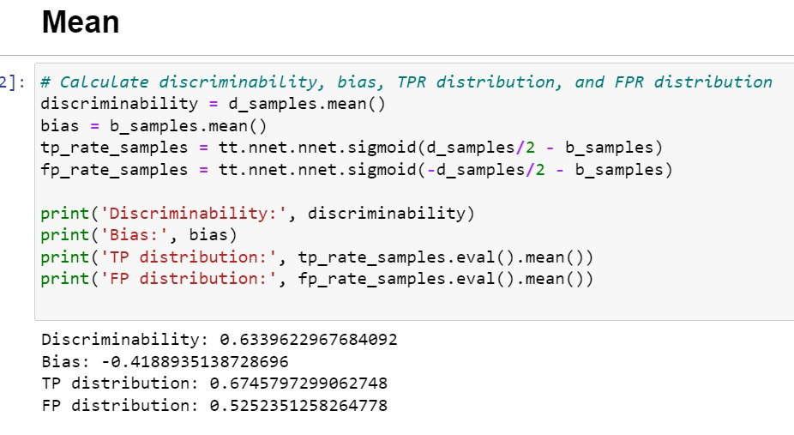
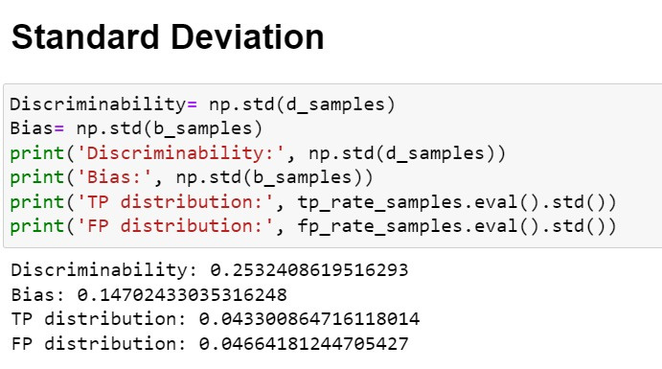
Analysis
Case 1
PAGE 08

Slide 9
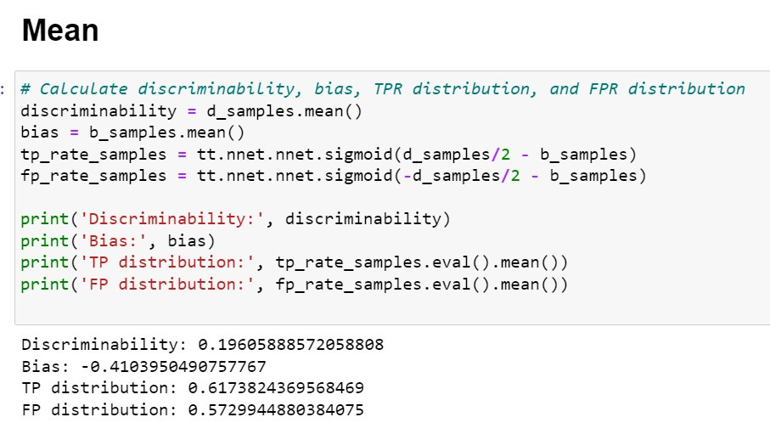
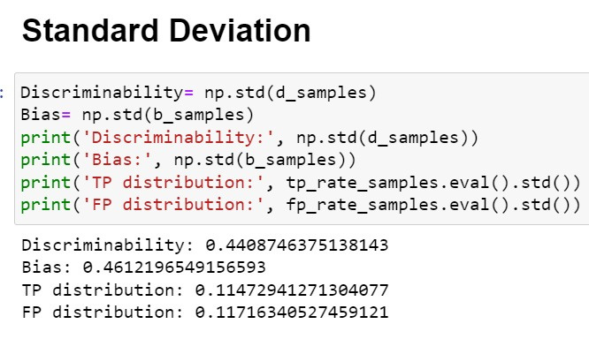
Analysis
Case 2
PAGE 09

Slide 10
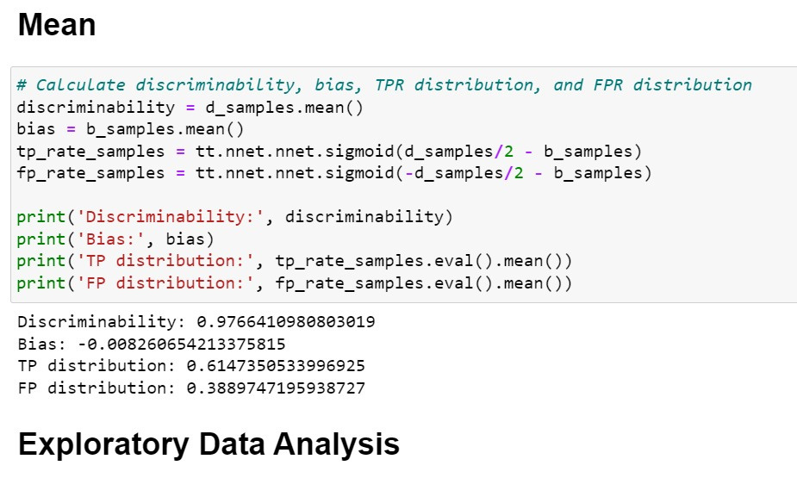
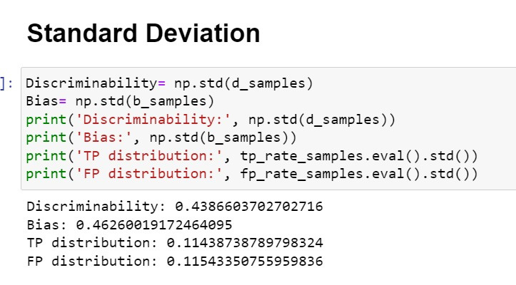
Analysis
Case 3
PAGE 10

Slide 11
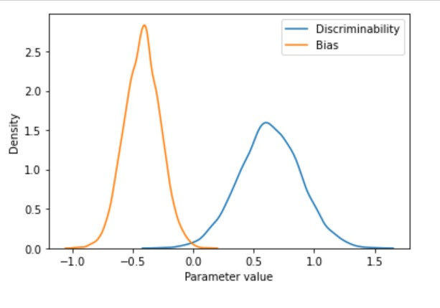
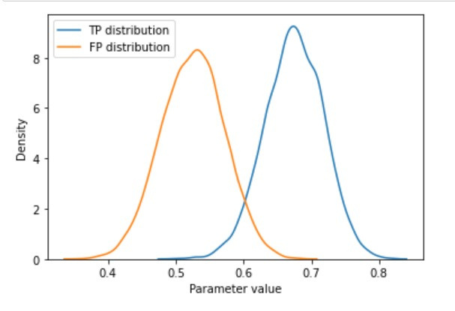
Results
Case 1
PAGE 11

Slide 12
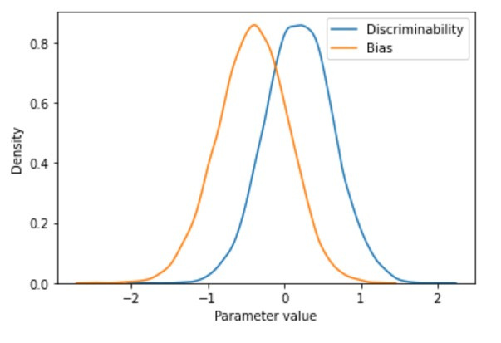
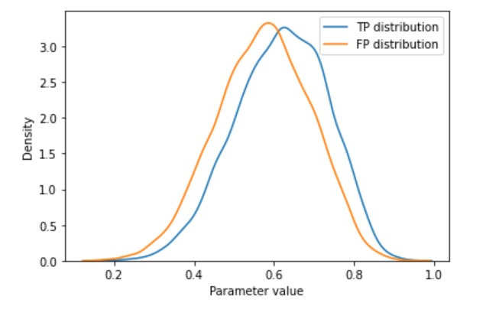
Results
Case 2
PAGE 12

Slide 13
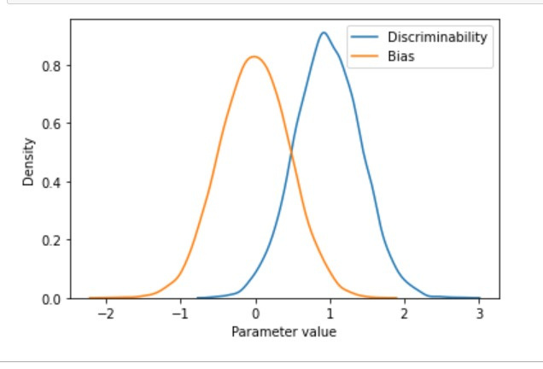
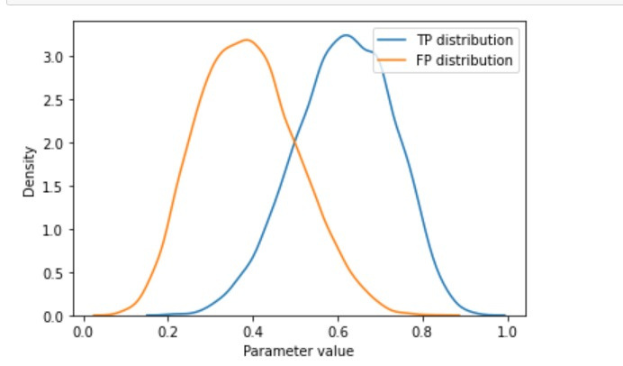
Results
Case 3
PAGE 13

Slide 14
CONCLUSION
In Case 1, participants displayed moderate discriminability (mean=0.6339, SD=0.253) with a slight bias towards negative values (mean=-0.41, SD=0.14). They achieved a relatively high true positive (TP) rate of 0.67 and a false positive (FP) rate of 0.52, indicating some ability to distinguish targets.
In Case 2, discriminability and bias increased compared to Case 1, yet TP and FP rates remained similar (TP=0.61, FP=0.57), suggesting comparable performance.
Case 3 participants exhibited the highest discriminability (mean=0.97, SD=0.43) and negligible bias (mean=0.008, SD=0.42). They achieved a TP rate of 0.61 and a notably lower FP rate of 0.38, indicating excellent accuracy in target discrimination with minimal false positives.
PAGE 14

Slide 15
CONCLUSION
These findings underscore the influence of experimental conditions and stimulus characteristics on discriminability, bias, TP rate, and FP rate.
In Case 2, wider credible intervals compared to Case 1 reflect the smaller sample size (10 trials for both target and noise), leading to increased uncertainty in parameter estimates. Conversely, Case 3 demonstrates high accuracy with no false positives.
Utilizing PyMC3 for these models provides a valuable tool for estimating parameters and understanding cognitive processes involved in tasks such as target detection.
Youtube Link: https://youtu.be/NpcuF4Bf-BM
PAGE 15

Slide 16



Thanks!
YOUTUBE VIDEO
GITHUB CODE
PAGE 16
THANKS!

